Slide 1

Driving to Success

Slide 2

Members
-Yevgeniy Denkovych
-Nnamdi Okoroji
-Kantai Melau
-Mihai Florea

Slide 3

Project Brief
Setting up a start-up car company that buys used cars to either sell or lease to clients.
Beneficial to analyse the existing car market.
We seek to get information such as:
Type of car
Year of Manufacture
Mileage
Price
Fuel
Transmission
This will enable us to make informed decisions.

Slide 4

Data Sets
We used 2 data sets for the information:
Kaggle (CSV)- https://www.kaggle.com/datasets/austinreese/craigslist-carstrucks-data
Web scraping the Autotrader website (JSON)-
https://www.autotrader.co.uk

Slide 5
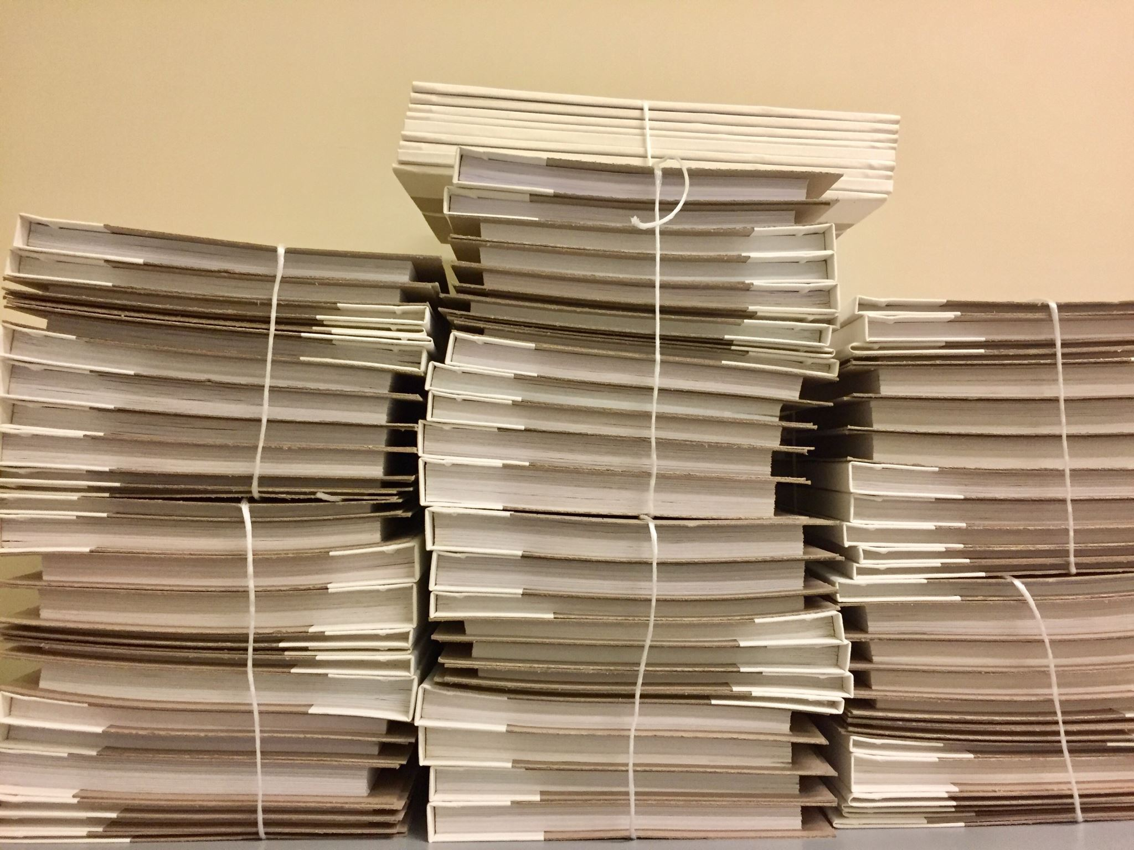
Extraction
CSV
File was downloaded from the source and connected through pandas to the Jupyter Notebook.
Web Scraping
Scrapping was done to produce a HTML JSON format
Accessed the page using BeautifulSoup and got the HTML in JSON format.
Scraped the results and stored the information in lists that contained the details that were required.
From the lists, the data was input and stored in a data frame.

Slide 6

Transformation
CSV
Displayed the columns
Cut out the columns that were unnecessary.
Dropped columns that did not have any values.
Renamed the columns.
JSON
Displayed the necessary columns
Cut out the unwanted information

Slide 7

Loading
Database Selected - PostgreSQL
Process:
Created the 'cars_db' database on the PostgreSQL
Created the 2 tables that would hold the information from the DataFrames.
Created a connection in pandas to the DataBase
Linked the DataFrames in pandas to the tables that had been created and displayed the information contained in the tables.

Slide 8
..And Finally
We are now ready to analyse the data in order to kick start our business from a data driven position.

Slide 9

Challenges
Accessing the information from Auto Trader ‘https://www.autotrader.co.uk’
This was due to the cookies pop up that we couldn’t figure a way to bypass.

Slide 10
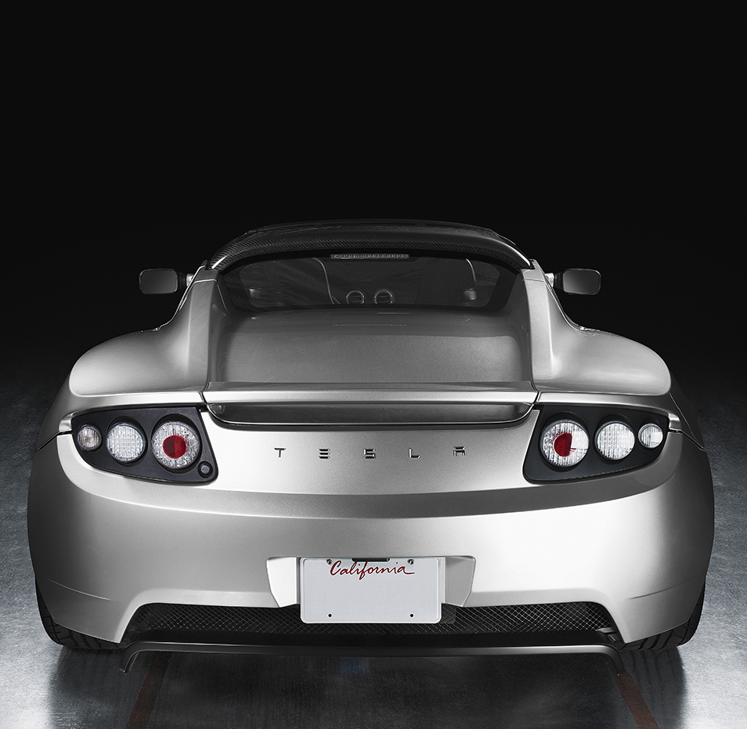
Thank you!!

